Slide 1
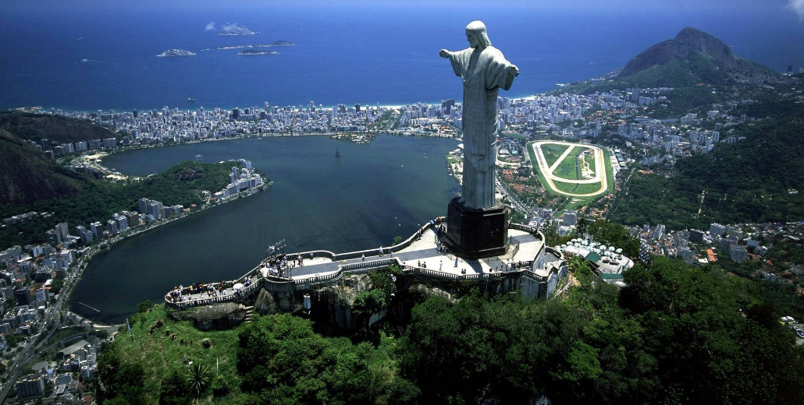
Car Accidents In Brazil
By: Osvaldo Morales, Carson Leung, Rezwan Rahman, Yuxuan Chen
Notes:
Rezwan

Slide 2
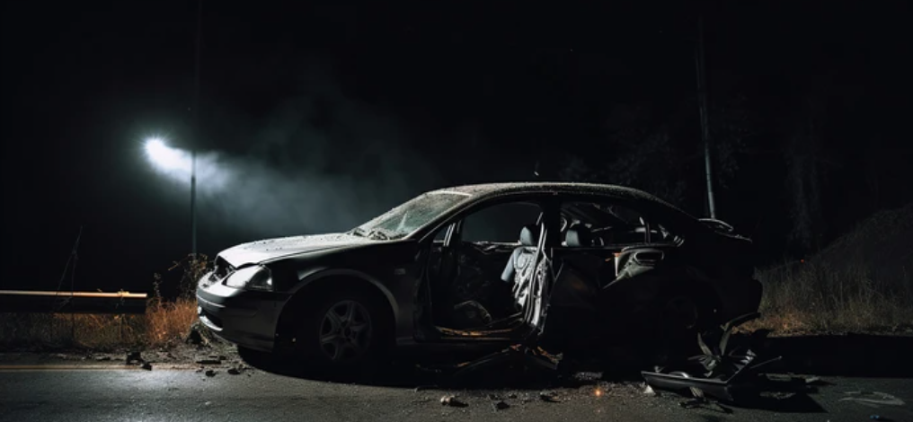
Introduction
What is a car accident? : Undesired situation where a car makes physical contact with an object.
Car accidents: How it happens?
Involves one or more car with a user operating.
Happens when the car makes contact with an object (car, person, wall, etc.)
Impact level(minor, major)
Takes place at a location(spatial), at a certain time (temporal).
What caused the crash? (Human error, irresponsible behaviour, mechanical malfunction, external factors)
Concluding result: injured, uninjured, or fatal results.
Through this presentation, we’ll explore:
Our dataset: car accident data, location, time, cause of accident, # of vehicles, weather, severity level.
Data integration: Seasons, state population, state density
Patterns and trends in car accidents across Brazil.
The relationship between factors like population and density with accident rates.
Is there any patterns between the weather and the car accident.
Are there any differences between car accidents during different seasons.
Car accidents during big events.
Why this is important: Car accidents are prevalent in everyday life. Analyzing car accidents can help give us a more incrative deeper understanding of why and how it happens. It's not something we can predict, but it is something we can do deep analysis of.
Notes:
Rezwan

Slide 3
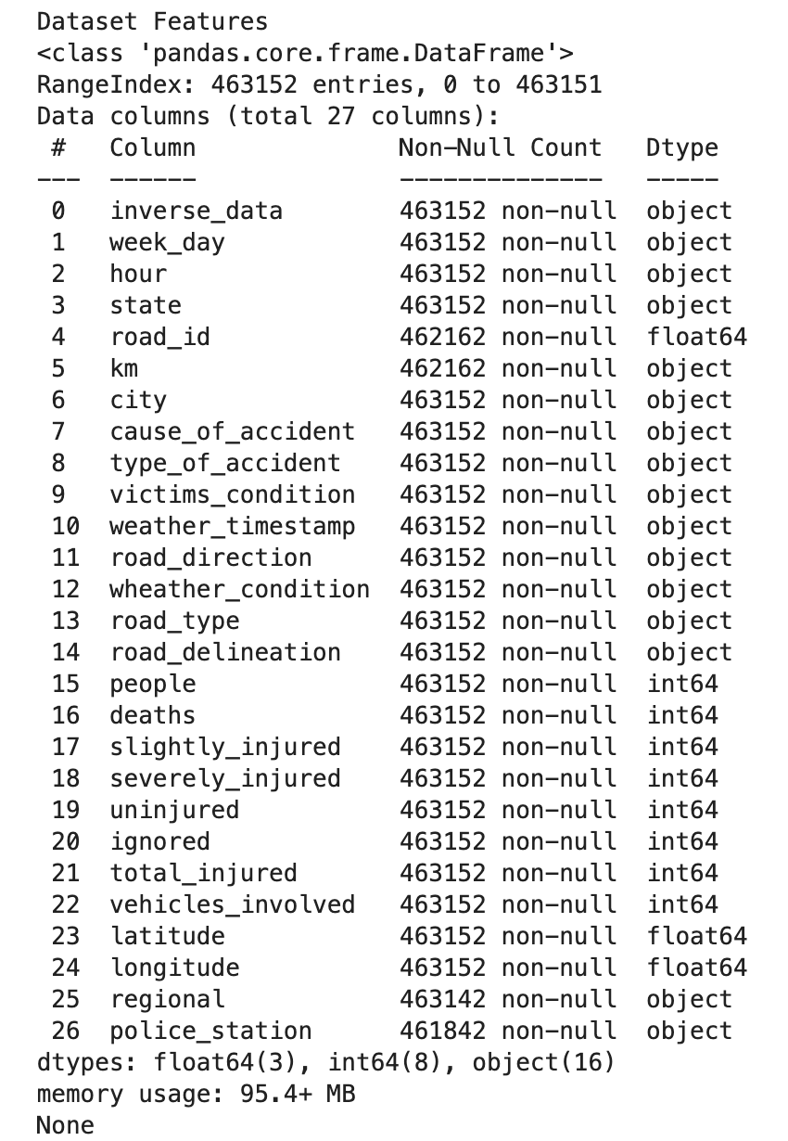
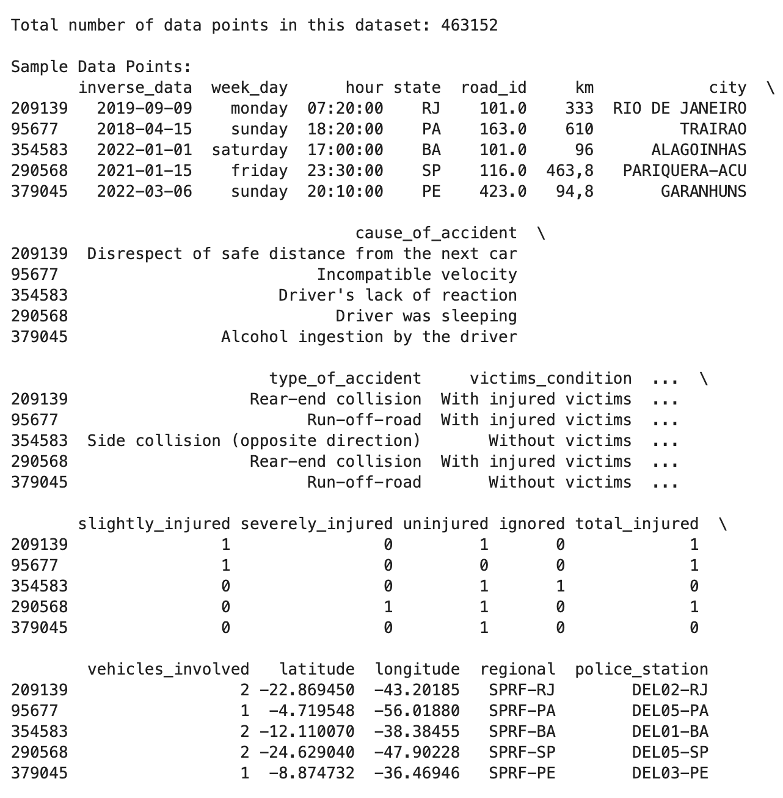
Dataset Features
Here are the features that we worked with. Something important to note is that this dataset was translated from Portuguese so some of the language might be a bit hard to understand.
We have a total of 463,152 data points to work with.
This dataset contains 27 features, ranging from categorical to numerical. We have categorical data relating to the city, state and we also have the latitudes and longitude of accident locations.
We really focused our efforts on a select few, as some features didn’t seem particularly relevant. For example the police station that responded to the accident appears in the dataset as a column but we didn’t really find a good use case for it.
We did had some missing and invalid data values. For example the ‘road-delineation’ (i.e. if the road was straight, curvy etc) column had some values as “Not Reported”.
Some of the latitude and longitude values placed the accident location outside of Brazil (some were even in the ocean!). So those data points had to be filtered out.
Features
Sample Data Points

Slide 4
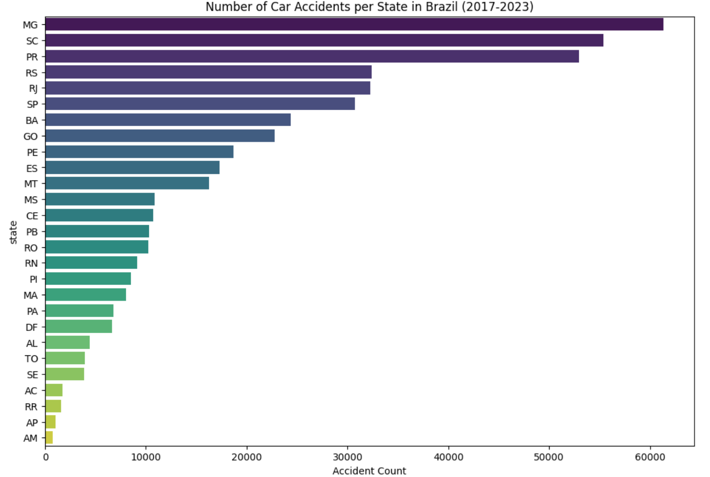
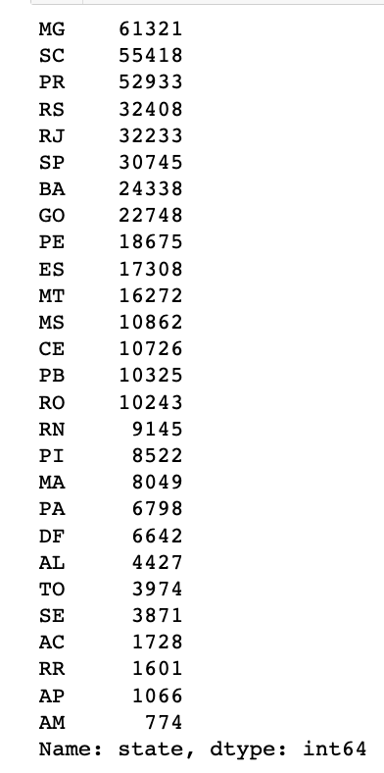
Car Accident Data
Top 5 highest:
Minas Gerais
Santa Catarina
Paraná
Rio Grande do Sul
Rio de Janeiro
What this shows:
What states are more dangerous in terms of car accidents.
Is this enough?:
No, not every factor was analyzed.
Notes:
Rezwan

Slide 5
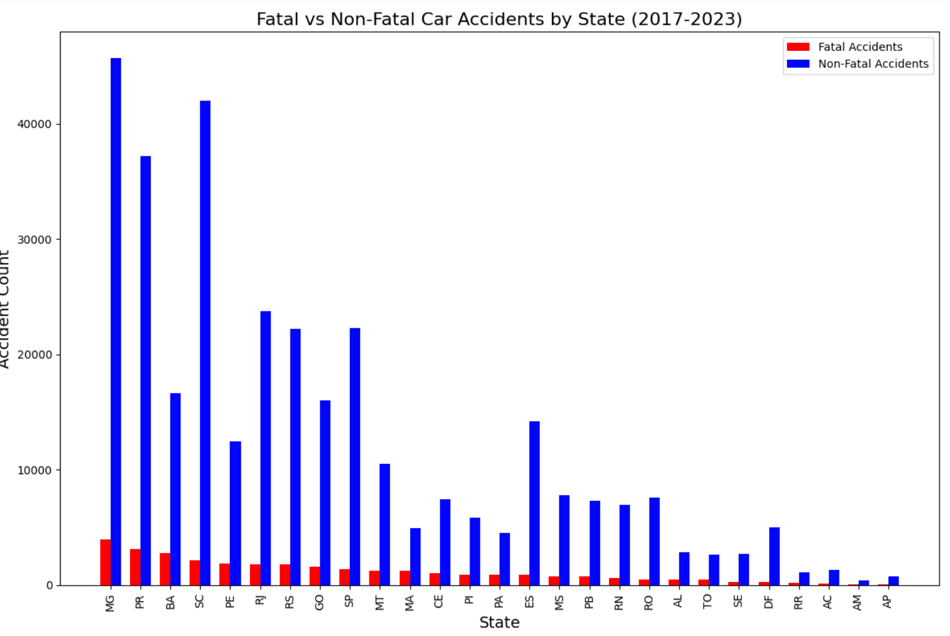
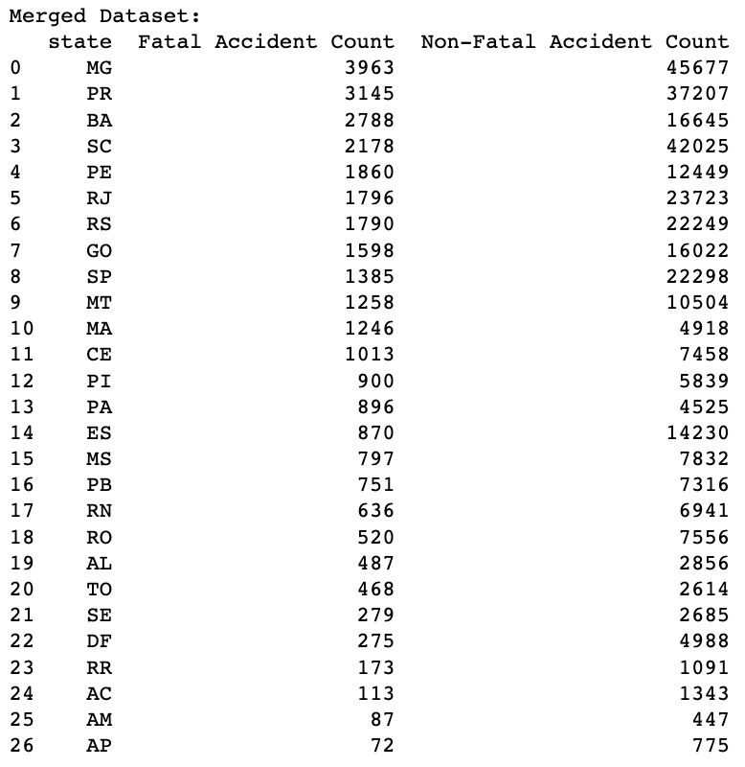
Fatal vs Non-fatal
Top 5 fatal:
Minas Gerais
Paraná
Bahia
Santa Catarina
Pernambuco
What this shows:
Gives us a better idea on what states have more severe car accidents.
Does this prove what states are more dangerous:
No, because population size, and state density hasn't been analyzed.
Notes:
Rezwan

Slide 6
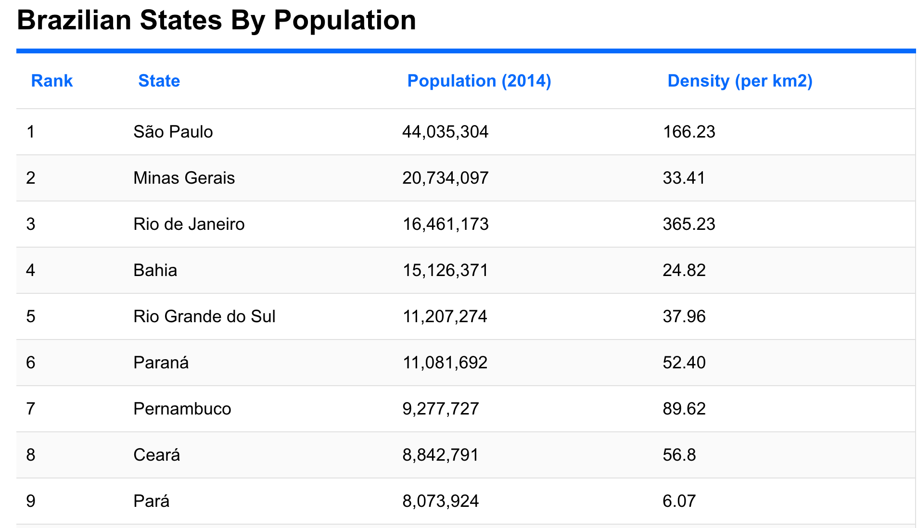
Data Integration
We found new dataset that contains addition features like population and state density.
We added new columns to our original dataset.
Now we have more features that can help us to understand which states are more dangerous in terms of car accidents.
We also added a seasons column which we will discuss later.
Notes:
Rezwan

Slide 7
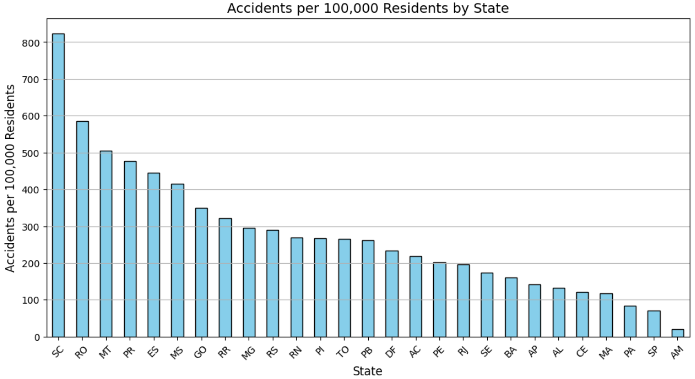
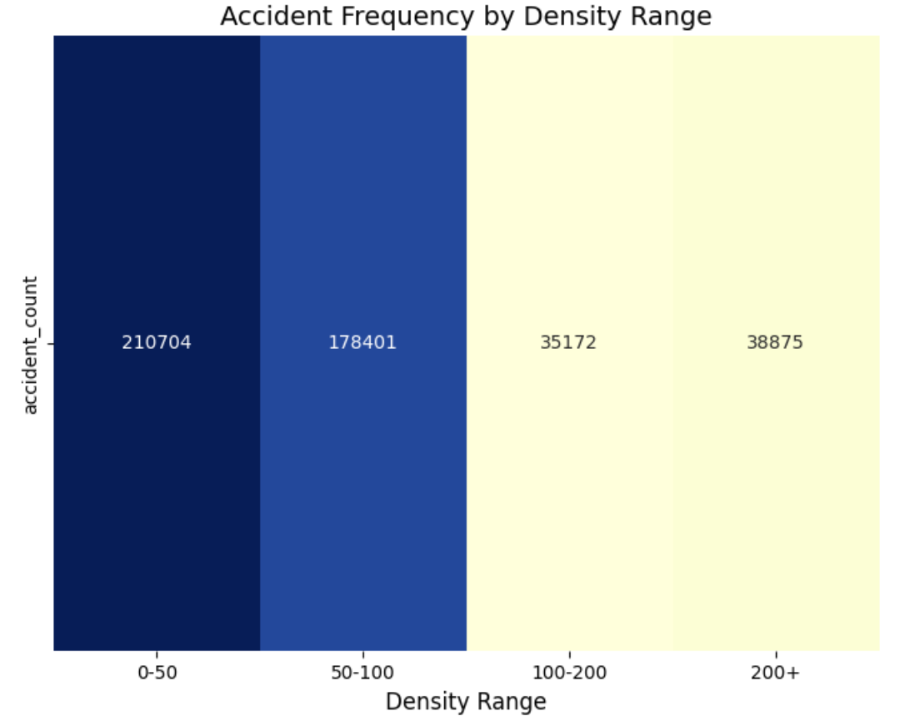
Population- Density accident analysis
Notes:
Rezwan

Slide 8
Population Density analysis conclusion
There are more accidents in states that are low in density and high in population.
Sao Paulo has the highest population (44 million +) yet only 6th most car accidents in Brazil. This is because of high state density (166.23)
Minas Gerais has the most car accidents in brazil because of high population (20 million+) and very low density (33.41). The same applies to Rio Grande do Sul. However, it still isn't the most dangerous.
The most dangerous city is Santa Clara because they have the highest accidents per 100,000 people. Density(65.27) , population(6.7million)
Notes:
Rezwan

Slide 9
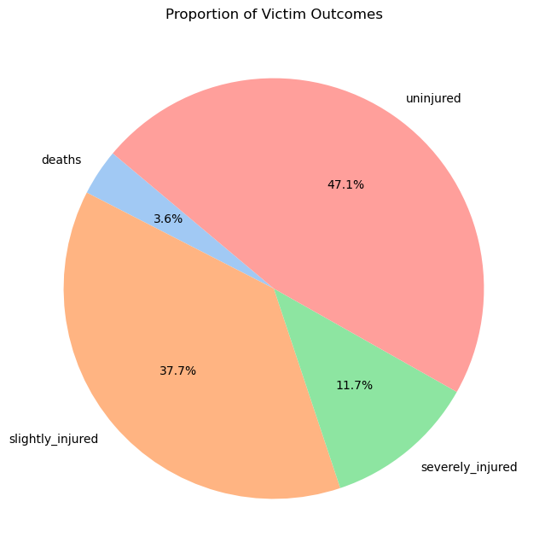
Severity of Accidents
Most accidents shown end up with people not being injured
However, our focus is on the the proportion that involves people being severely injured or killed in these car accidents

Slide 10
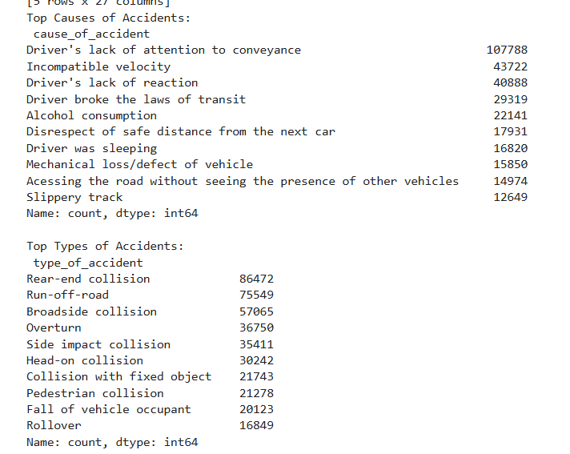
Types/Causes of Accidents
Human error?
Majority of the causes are of human error
Mechanical error?
Only one cause is from mechanical error
What does that imply?
The lack of responsibility on the road are the leading causes to car accidents

Slide 11
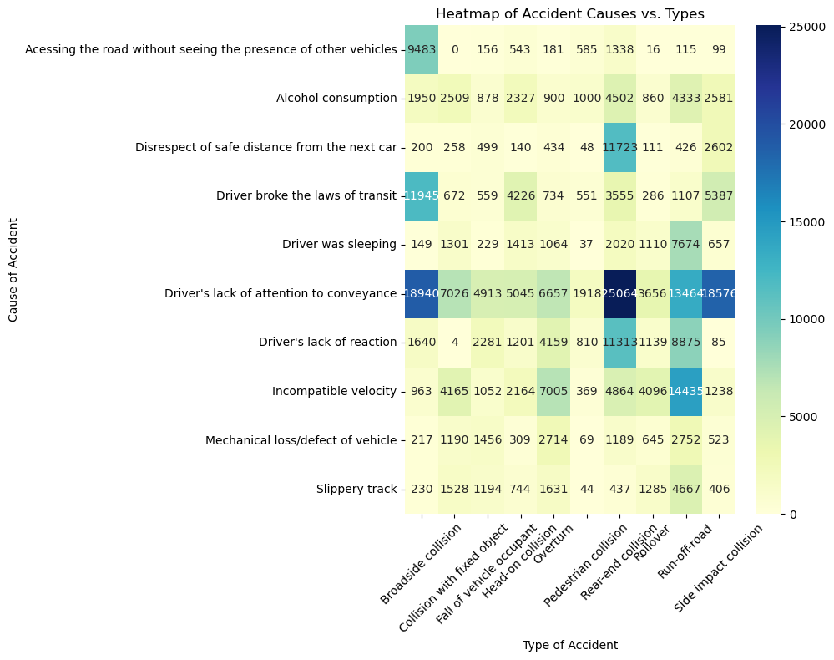

Slide 12
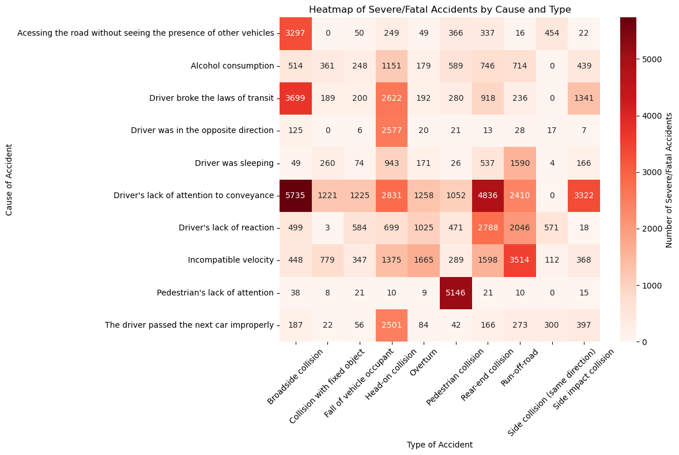

Slide 13

Seasons in Brazil
Opposite of our seasons
Summer: December, January, February
Fall: March, April, May
Winter: June, July, August
Spring: September, October, November

Slide 14
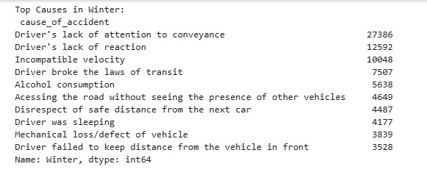
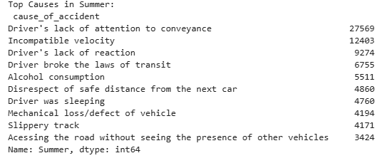
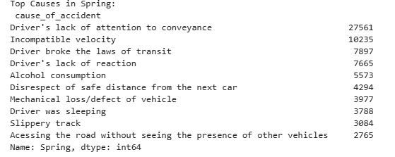
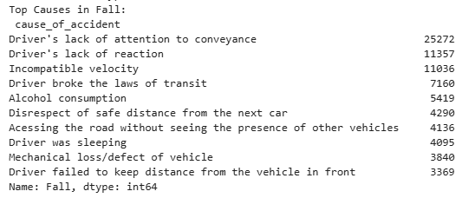

Slide 15
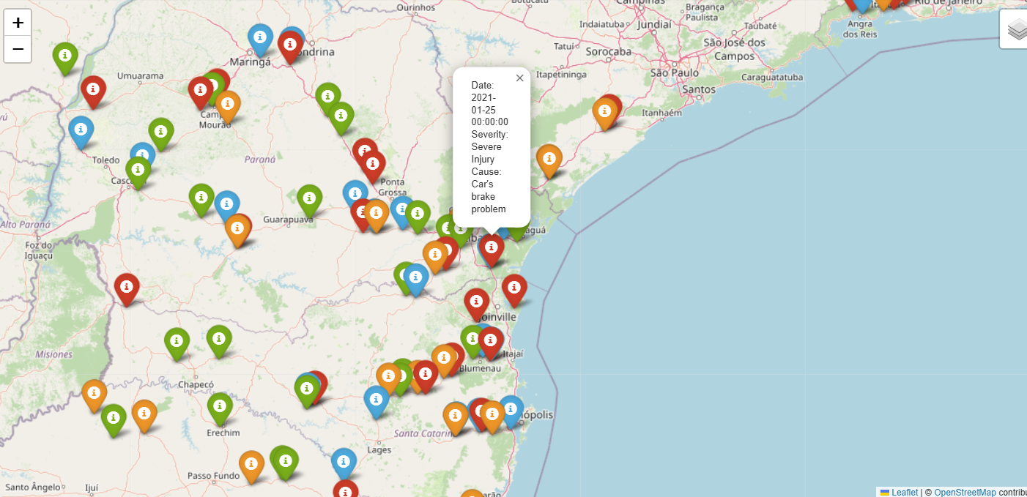
Red = Summer, Green = Spring, Blue = Winter, Orange = Fall

Slide 16
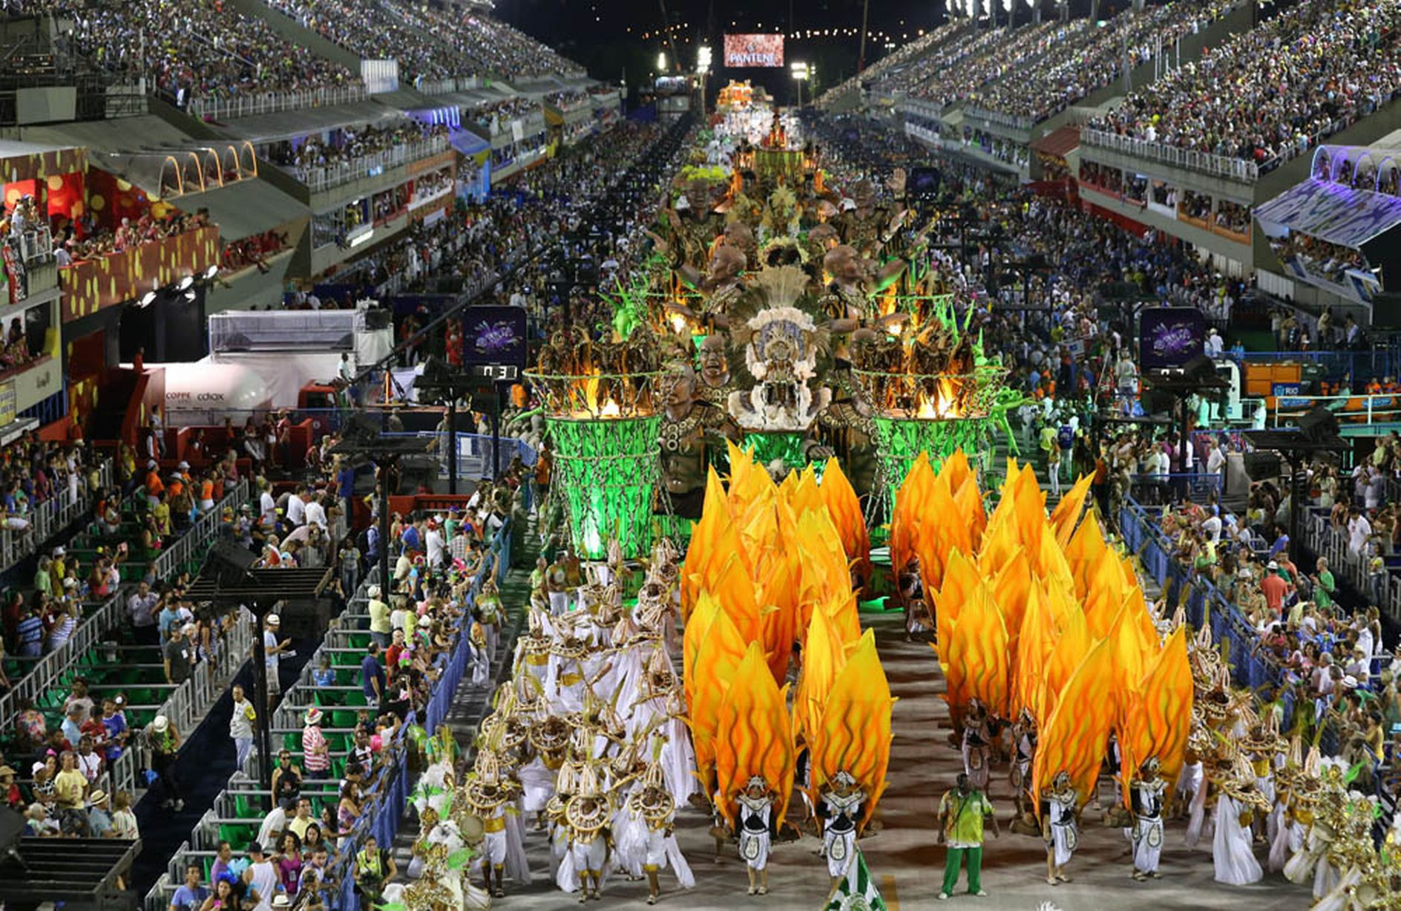
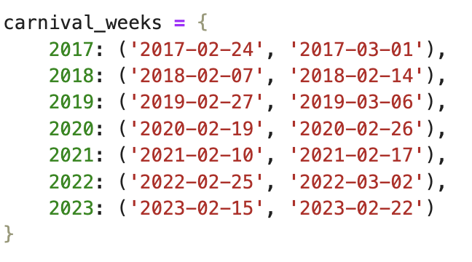
Carnival in Brazil - The Biggest Party of The Year
Carnival in Brazil is a festival held annually before Lent. Highlights include the Sambadrome parades, where samba schools compete with performances in elaborate costumes (which they spend the entire year crafting), and huge street parties that bring millions out onto to the streets as they celebrate the holiday. It officially begins the Friday before Ash Wednesday and ends on either Shrove Tuesday or on Ash Wednesday so there are about 5 days of celebration. Ash Wednesday can occur between February and early March. Rio de Janeiro hosts the biggest Carnival in the world and attracts the largest crowds with around 7 million visitors, including 1.5 million tourists.
We wanted to see if there was any particular effect on the distribution of car accidents during this time period, considering the influx of tourists to the country as well as possible road closures and an increased police presence.
Even though the official start day for Carnival is the Friday before Ash Wednesday it may differ by state and cities in Brazil. Some people may celebrate the week before or celebrations may last the entire month in some parts. So for the purposes of this analysis we decided to define Carnival week as the week ending on Ash Wednesday of that year (converted to pandas datetime objects aft for comparison).

Slide 17
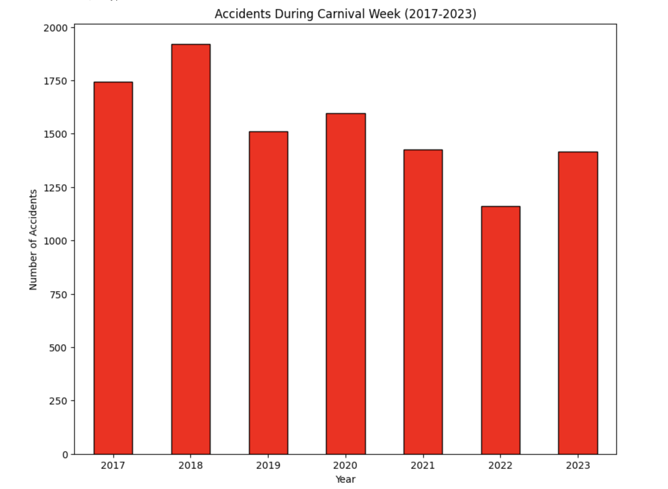
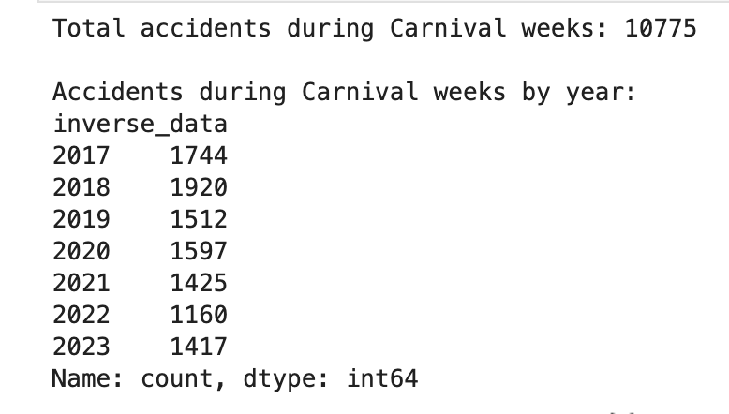
Carnival Week Accidents
Here’s the breakdown for the number of accidents that occurred each year during Carnival week.
This bar graph doesn’t take into account where the accidents occurred, only when they occurred.
It was difficult to pin down whether Carnival had a direct impact on these accidents (i.e. road closures, redirected traffic, number of people out on the streets)
Interesting to note that even though Rio de Janeiro has the biggest Carnival in the world, it only has 1391 data points in the entire dataset over the six years recorded.

Slide 18
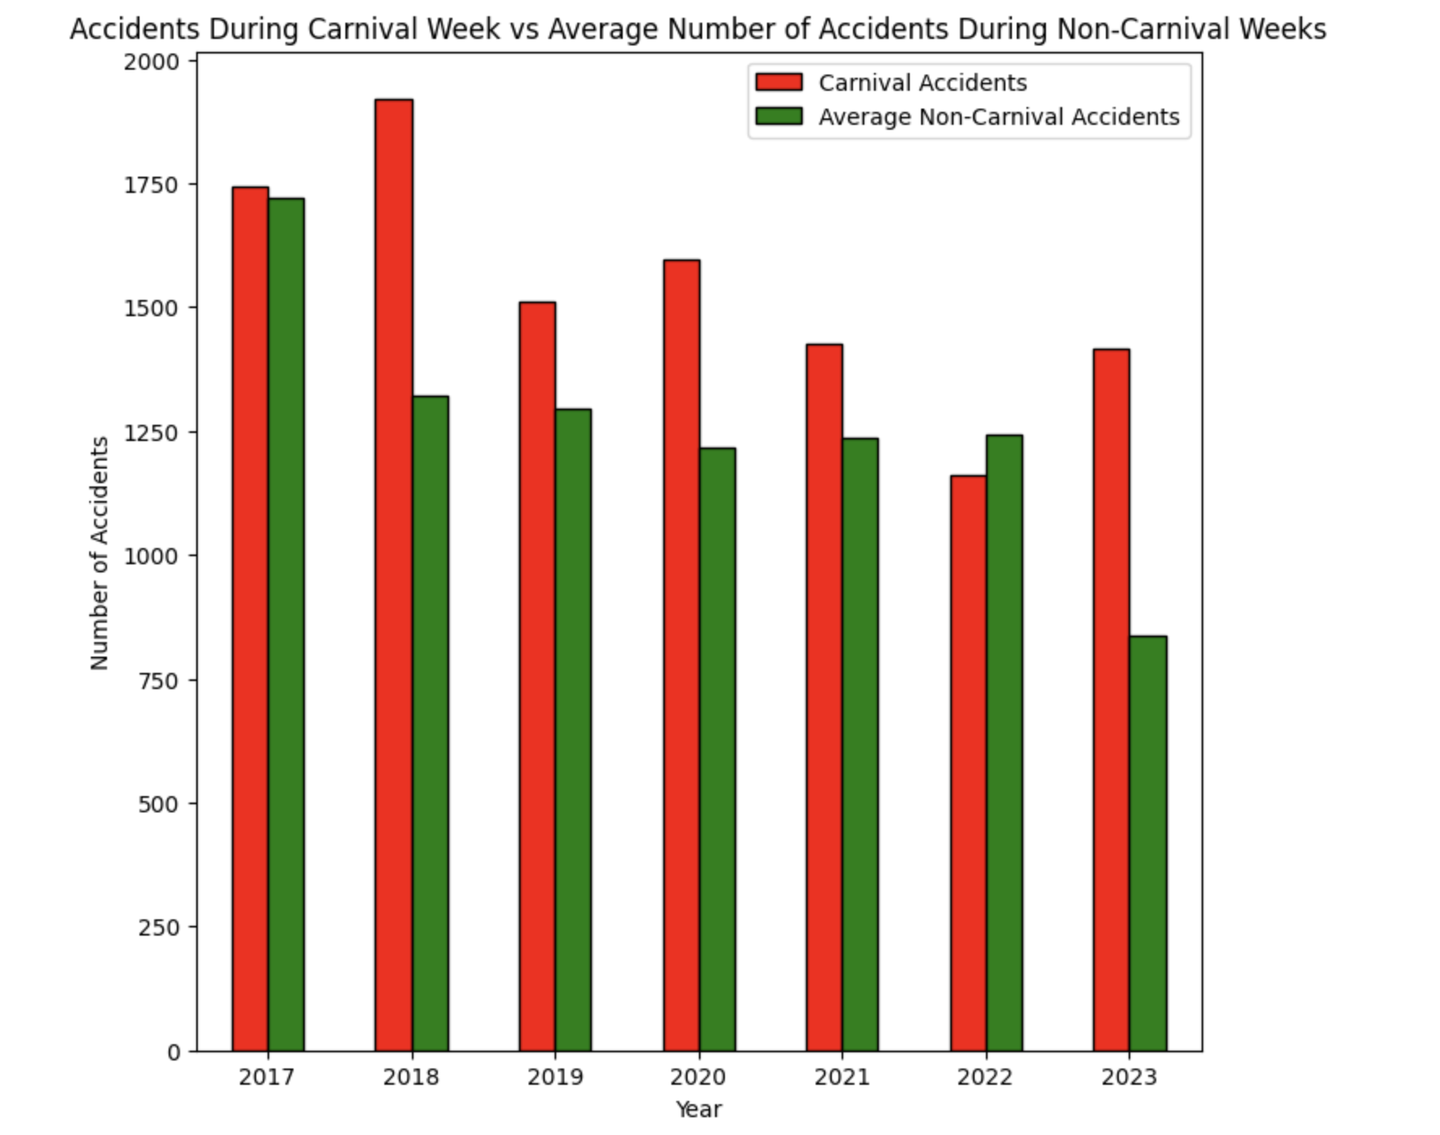
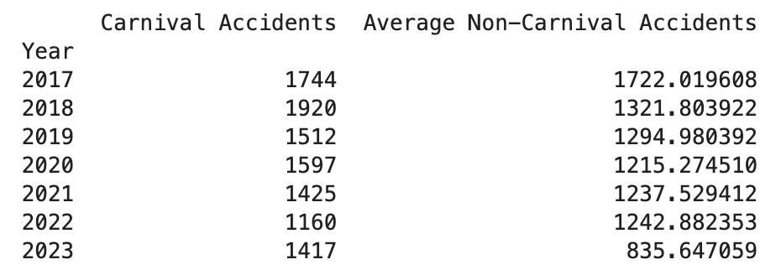
Comparing Accidents Data During Carnival Weeks and The Rest of The Year
Here we can see that the number of car accidents that occur during Carnival is comparable to average number of accidents per week during the rest of the year. (Except maybe for 2023 only because this dataset goes up to August 2023).
The average number of accidents that don’t occur during Carnival was calculated by excluding the data points determined to be within a Carnival week for each year and then dividing that number by 51 to get the weekly average.

Slide 19
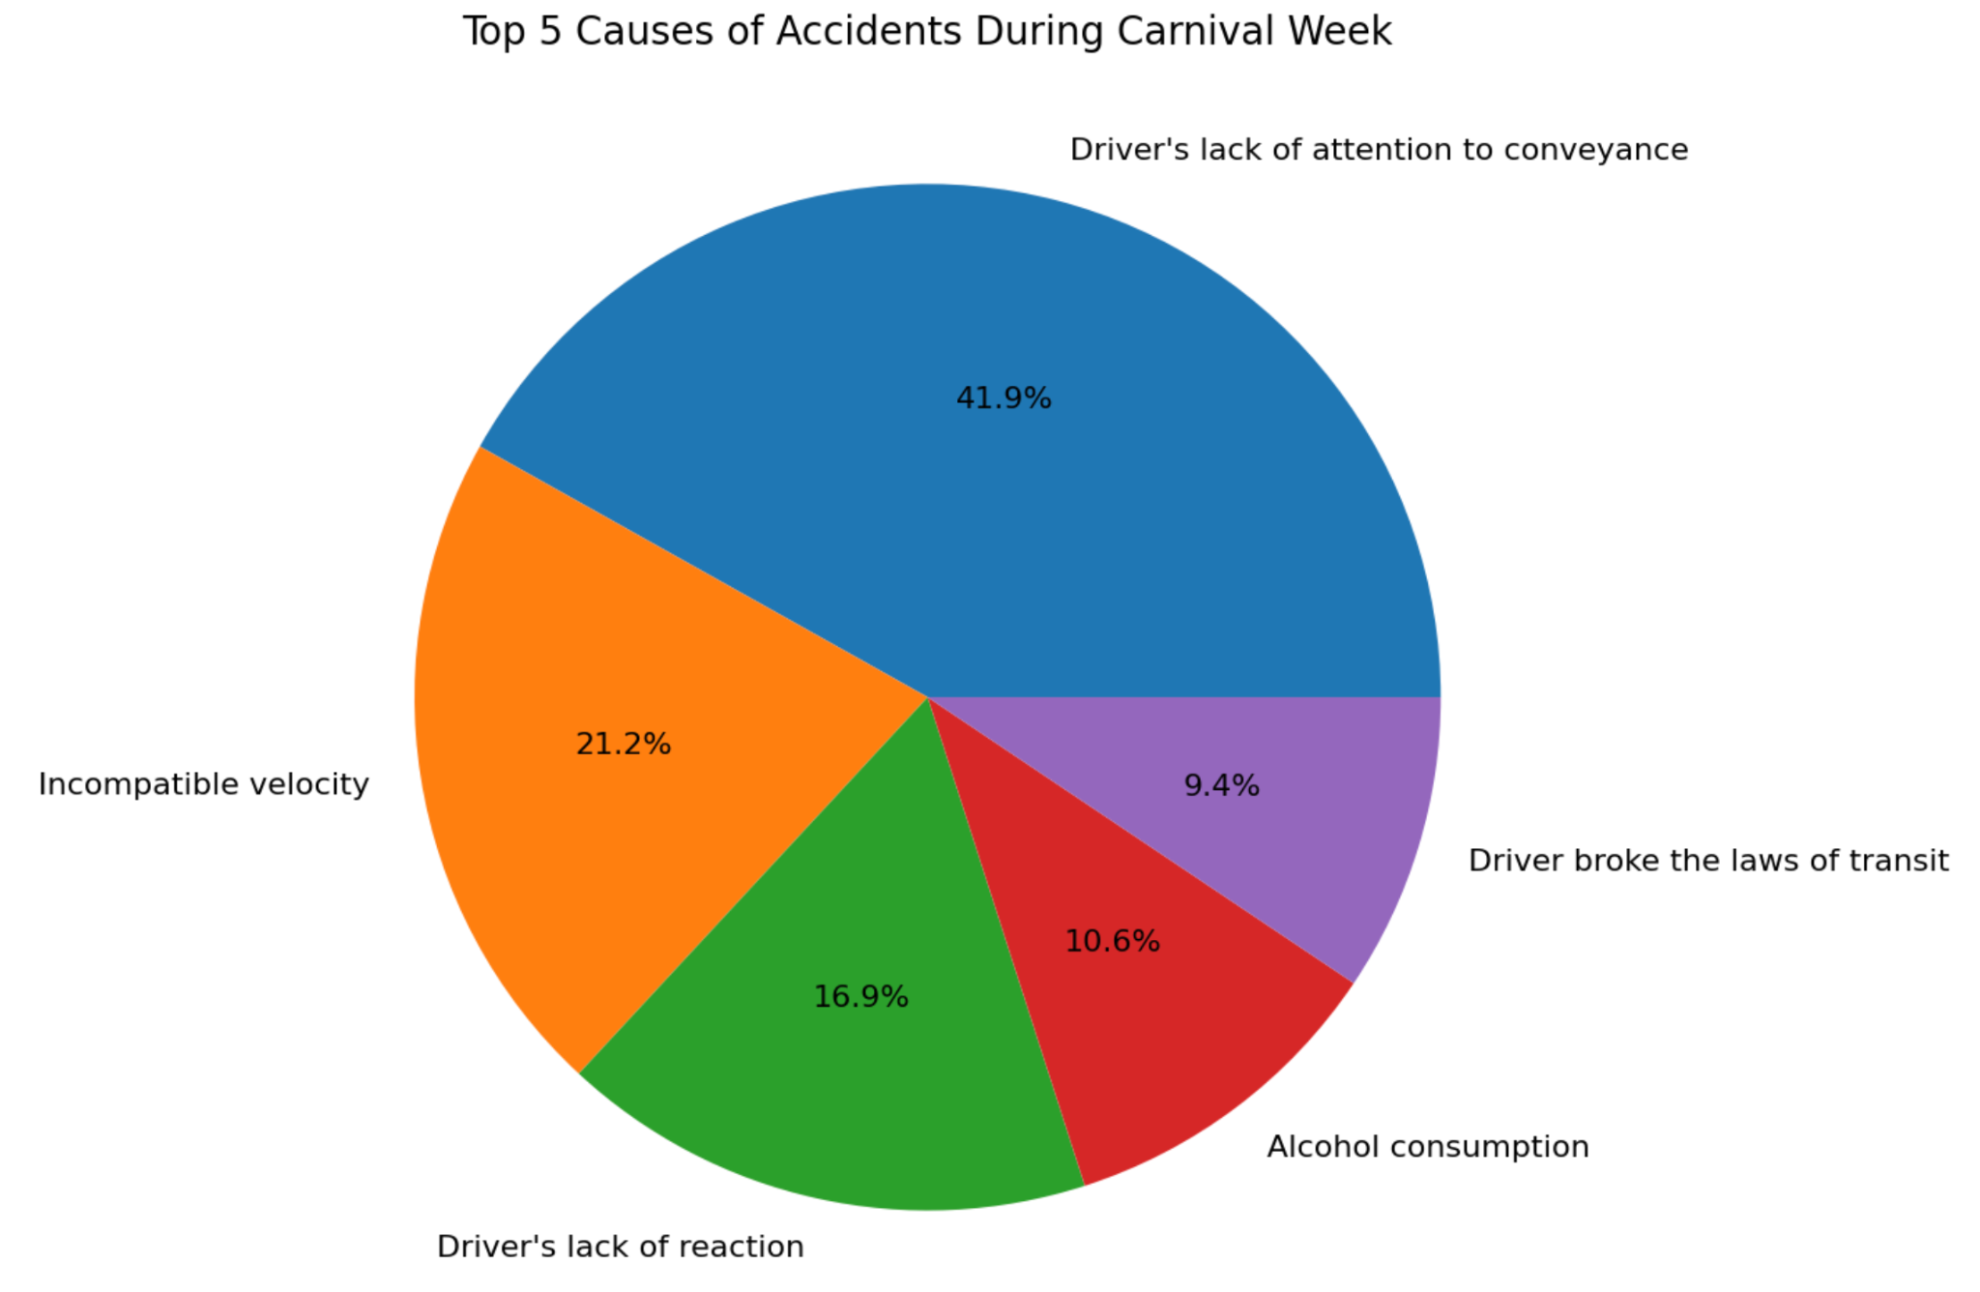
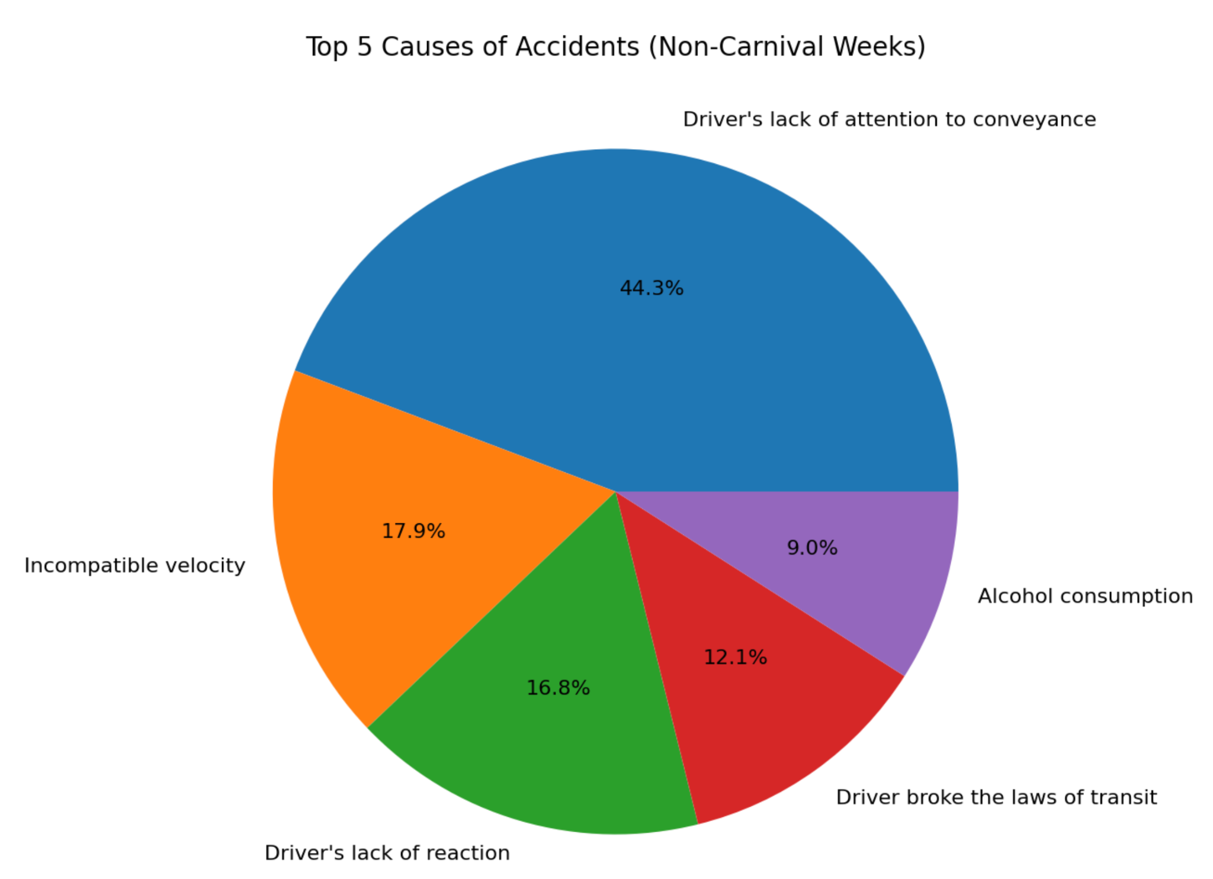
As you can see the top 5 causes are very similar for both types of weeks. The only real change that occurs is “alcohol consumption” and “Driver broke the laws of transit” switch positions for 4th and 5th place.
Again, because this dataset was translated from Brazilian Portuguese, “incompatible velocity” most likely means speeding in this case.
Top 5 Causes of Accidents During Carnival Week vs Non-Carnival Weeks

Slide 20
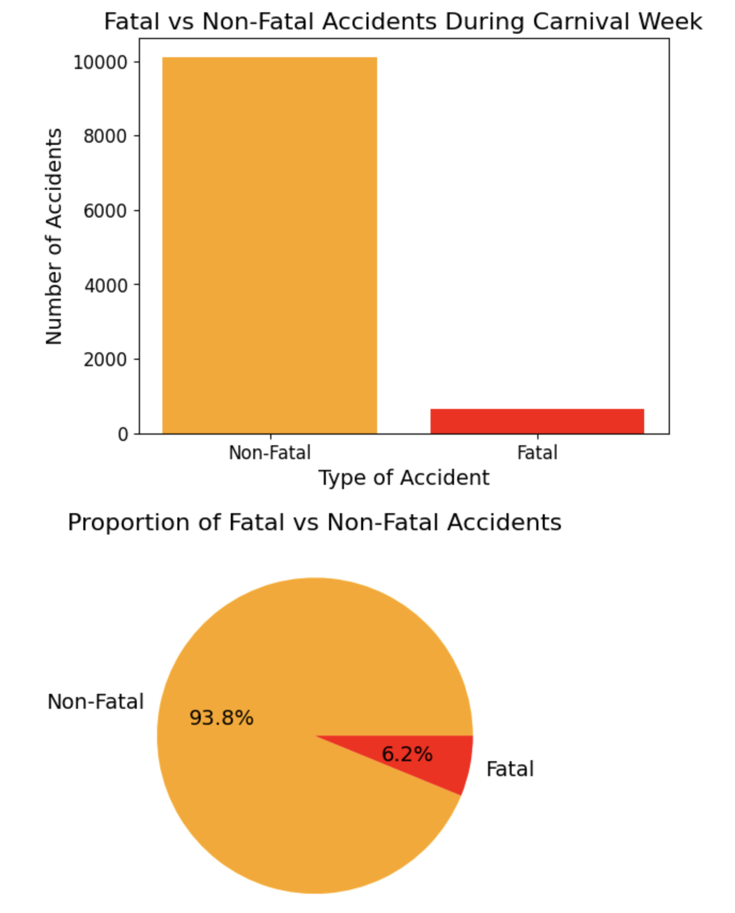
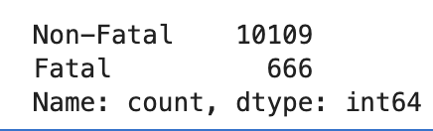
Overall Proportion of Fatalities During Carnival Week
Comparing the number of accidents that resulted in death vs non-fatal accidents during the week of Carnival (these include every year in the dataset, from 2018 to 2023)
As you can see most accidents ended up with non-fatal injuries and 0 fatalities (at least at the time the data was recorded). A non fatal injury is defined in the dataset by the features “slightly_injured”, “severely_injured” and “uninjured”.
So after reviewing the data, we can estimate that Carnival specifically is not the most dangerous time of year for car accidents.
😈

Slide 21
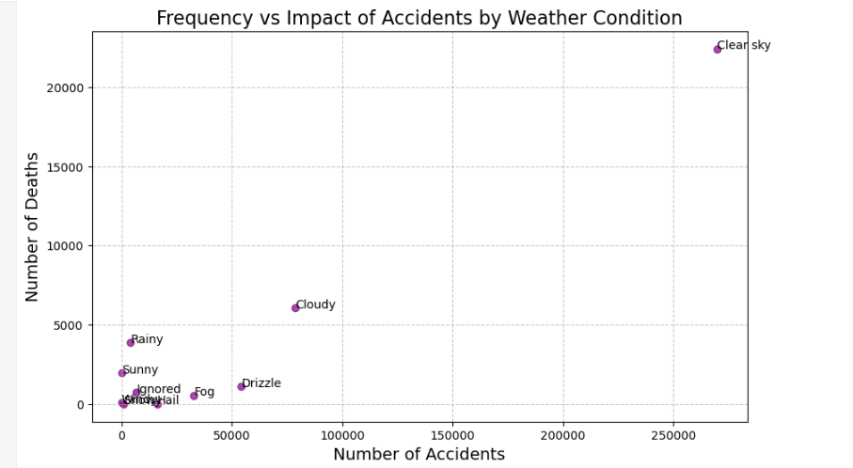
Weather Condition
Clear Sky: Most accidents and deaths happen in clear weather, likely because it’s the most common condition with more cars on the road.
Cloudy Weather: Causes a moderate number of accidents and deaths, less than clear skies but still noticeable.
Other Weather: Rain, snow, fog, hail, and drizzle have fewer accidents and deaths, but they can still be risky when they occur.

Slide 22
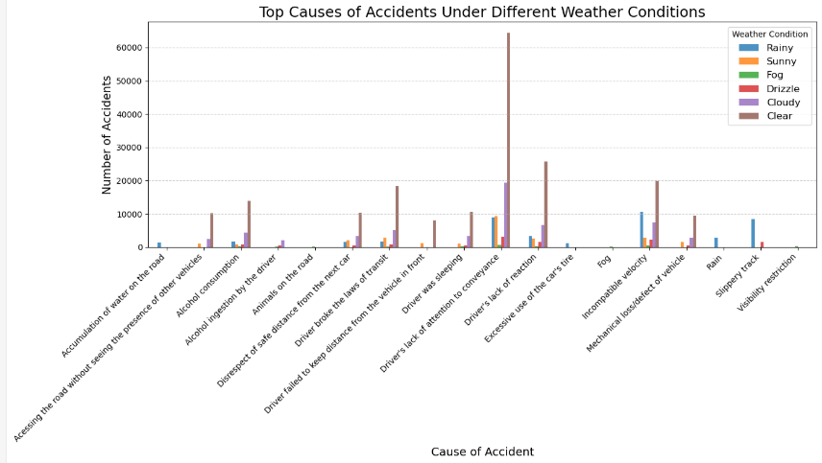

Slide 23
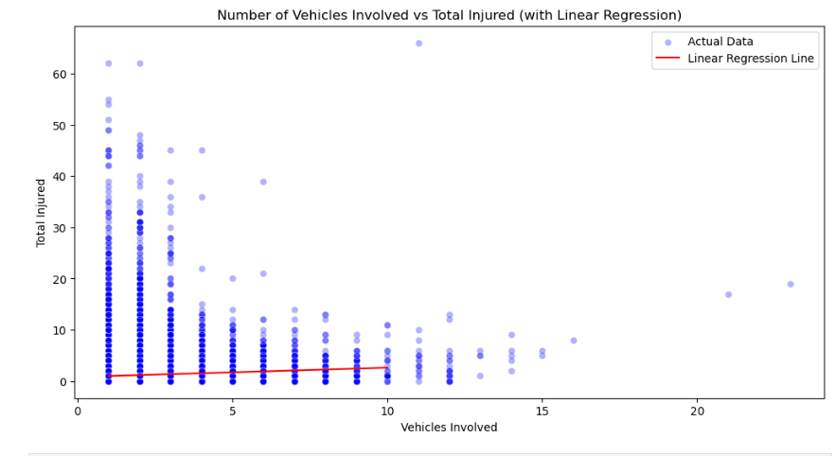
Prediction(Linear)
Predictions for Vehicles Involved (1 to 10):
vehicles_involved predicted_total_injured
0 1 0.98
1 2 1.16
2 3 1.34
3 4 1.52
4 5 1.71
5 6 1.89
6 7 2.07
7 8 2.25
8 9 2.43
9 10 2.61

Slide 24
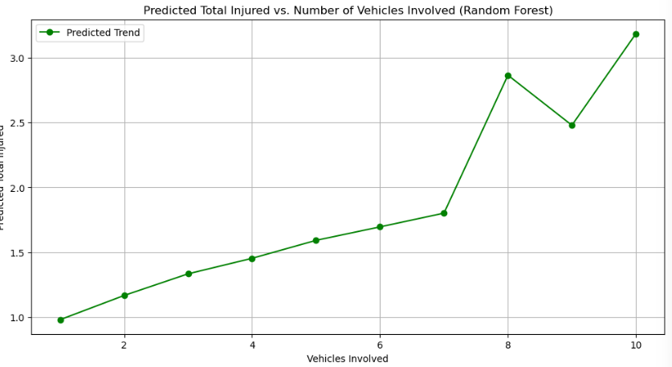
Prediction - Random Forest
Predictions for Vehicles Involved (1 to 10):
vehicles_involved predicted_total_injured
0 1 0.98
1 2 1.17
2 3 1.33
3 4 1.45
4 5 1.59
5 6 1.69
6 7 1.80
7 8 2.87
8 9 2.48
9 10 3.19
Both models have nearly identical MSE values, indicating that their average error in predicting total_injured is very similar.

Slide 25
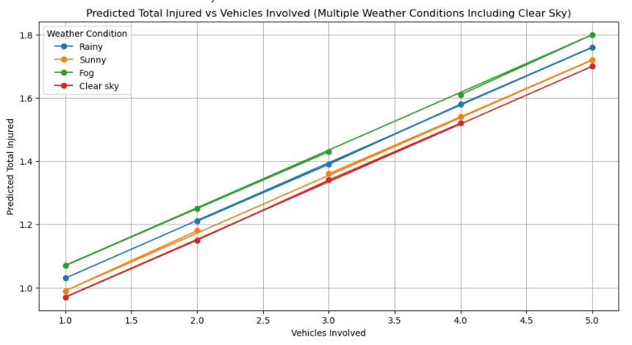
Linear Regression with One-Hot Encoding
Rainy Conditions:
Rainy weather consistently predicts higher injury rates compared to other conditions.
Linear regression and random forest models were applied to predict the number of injuries based on vehicles involved.
Weather conditions: clear skies have the highest number of accidents but the rain and fog posed significant risk.
These two method aligns well with the dataset’s structure. Both models have show similar MSE values, showing consistency in predictions. Effectively identify the high risk conditions and accident trends across seasons.

Slide 26
Conclusion
Key Findings
Weather conditions (e.g., fog, rain) significantly affect accident severity, with fog being the most dangerous.
Linear and Random Forest models provided similar predictions but failed to fully capture real-world complexities (e.g., non-linear relationships).
Events like Carnival did not appear to have as much an impact on accident patterns, which was surprising given the human factors involved (e.g., alcohol consumption). Perhaps data related to car accidents in Rio de Janeiro (the biggest Carnival celebration in the world) is not publicly available?
High population and low density leads to more car accidents per state.
Improvement for future analysis
Include more factors
Use different method (Naive Bayes, K-Means or other regression models)

Slide 27
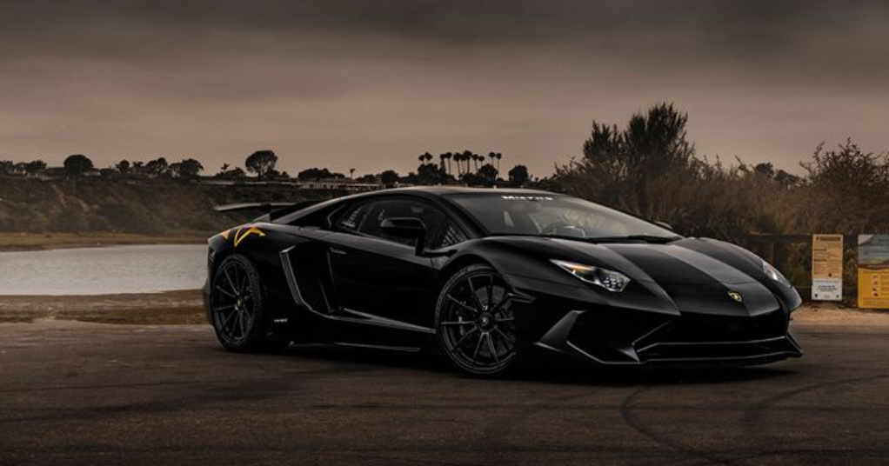
Questions?

